Slide 1
Attacking the network

Slide 3
Last lecture: how the network works
This lecture: How networks are attacked
Attacker’s methodology
Attacker’s goals
Reconnaissance

Slide 4
The Methodology
Footprint
Scan
Enumerate
Penetrate
Attack
Cover tracks
Install back doors

Slide 5
Footprinting
Gathering information about the target: research
Technical information
IP addresses
Web presence(websites, email servers, ect)
Recent security events
Or not:
Contact details
Phone numbers

Slide 6
Footprinting tools
Tell you information about the server
Many web tools
who.is
w3dt.net
Also OS based tools
nslookup
Always try multiple tools to get a good read

Slide 7
Footprinting
Don’t forget about cyberstalking social engineering:
Linkedin, Facebook, Researchnet, ect to get information staff
Dumpster diving: stealing old info from rubbish bins
Could get emails and personal information for a spear phishing attack

Slide 8
Scanning
Determines which of the systems are ‘net accessable
Which IP addresses are accessable
What they are running
Any obviously open doors
At it’s most basic:
ping the address to see if it’s alive
Scan the ports to see if any are open

Slide 9
Scanning
Identifies open ports
Google the port numbers: gets applications
Google the applications: get vulnerabilities
More on port numbers:
1-1023 are system: used by the OS
1024-49151 are registered for a specific purpose
49152-65535 are custom; used for whatever the user wants.

Slide 10
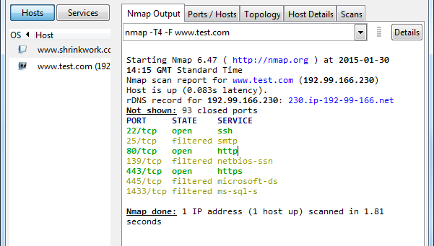
Scanning: Nmap output

Slide 11
Scanning
To connect to a port: port must be Open and Listening
Can just try and establish a TCP connection to the port:
Gives the system your IP address, details of the program used to connect, ect.
Instead, attackers use sneaky manipulation of TCP protocol

Slide 12
Scanning
Send a TCP FIN packet
Does not make a connection attempt; circumvents firewalls
If the port is in LISTEN, no reply
If the port is in CLOSED, responds with RESET
Send a SYN packet
If port is open, responds with SYN/ACK
You return RESET, no connection

Slide 13
Scanning: dorking
Dorking: using advanced Google searches to reveal vulnerable websites
Example: inurl:"installer-log.txt" intext:"DUPLICATOR INSTALL-LOG“
Searches for any Wordpress site moved using the Duplicator plugin
Reveals directory information, plugin version, server software, internal structure.
www.exploit-db.com/google-dorks/

Slide 14
Enumeration
The process of identifying ‘low hanging fruit’ and user accounts
Scanning shows you the doors, enumeration identifies how to get through them safely
Long process, usually involving many automated queries of some kind

Slide 15
Enumeration
An example: Usernames
Target: some system with password-based authentication (i.e. most of them)
From your footprinting, you have identified a list of users of your target
So, start testing possible usernames in the logon
Email addresses
Known aliases

Slide 16
Enumeration
By inspecting the return, you can tell whether a username exists or not
Eg. The server returns ‘invalid username’ if the user does not exist, and ‘invalid credentials’ if it does
Using this, you can build a list of valid usernames

Slide 17
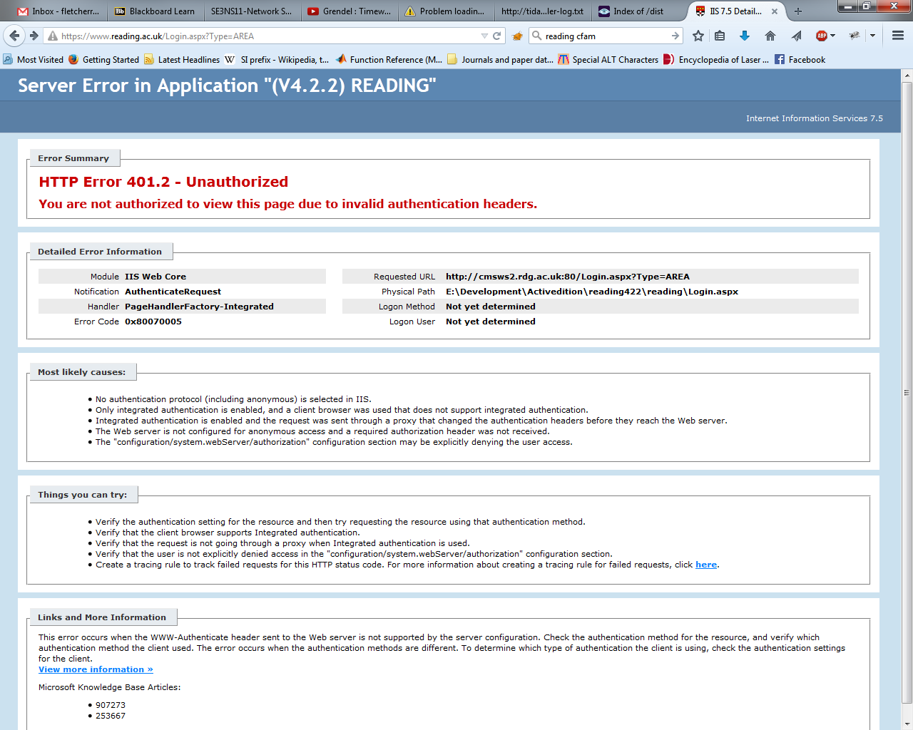
An example from close to home

Slide 18
Enumeration: spidering
Spidering: automated mapping of a website or filesystem
A program that recursively follows all links in a HTML document
Can expand to include common directory names, hidden files, ect
Can reveal old, insecure pages, backups, unreleased content, databases connected to site….

Slide 19
Penetration
Entering the system using information discovered up till now
Once a system is penetrated, the attacker has all the access required for their objective
More on this later!

Slide 20
Attacking
The attacker accomplishes their goal
Goal could be:
Theft of info
Denial of service
Defacement of web pages
Escalation of privilege
Using one attack to effect another, larger attack
See if they can
Attacks are only limited by the attackers imagination

Slide 21
Covering tracks
Inexperienced attacker leaves evidence
Attacker’s IP address
Attacker’s ISP
Attacker’s organisation
Attacker’s machine

Slide 22
Covering tracks
Professional attackers:
Turn off event logging
Clearing event logs
Better for them to know that someone was there easily than find out who with a little work
Hide malicious files that they’ve left behind (see the next bit)
Disguise files as other files
Hide evil files inside good files
Notes:
Type evil.txt > good.txt:evil
Del evil
More good.txt:evil > evil.txt
Con

Slide 23
Installing backdoors
Your attacker has done all this hard work: why do it again?
Installs a back-door to make intrusion easier
Could be:
Rogue user account
Scheduled job
Hidden program
Startup process

Slide 24
A quick example
Create two files, ‘good.txt’ and ‘evil.txt’
In the command line, ‘type evil.txt > good.txt:closet’
This pipes the content of evil into a datastream called ‘closet’ in good
Delete ‘evil.txt’, look in the file
Then, ‘more < good.txt:closet > evil.txt’
Ta-da!

Slide 25
Attacking a web server
Identify all entry points
Entry point: something you can do to make the server do something
Examine the structure of the entry points
What form does the request take?
What does it look like each part of it does?
What happens if you circumvent validation?

Slide 26
Attacking a web server
Are there none-HTTP ways of communicating with the server?
Text service? Email commands? API?
Does the server use another system that you can manipulate or spoof?
What does Nmap say?
Identify the server software
Enumerate, as detailed earlier
Research for known vulnerabilites

Slide 27
Summary
Information is all!
The more you know about your system, the more you can defend it
The less the attacker knows, the harder it is for them to attack
As admin, you must
Know how the attackers work
Know their tools
Know the methodologies

Slide 28
One more time: Use these tools ethically and legally! Find gaps, and plug them.

Slide 29
Next week: Denial of Service attacks

